Slide 1
Deliverable 4
The JRS
Jaskirat, Raymond, Samuel
2020-04-10

Slide 2
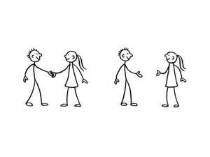
Team (Re)introductions
Jaskirat
Raymond
Samuel

Slide 3

Problem Statement
Current demonstrations phones are out of date, the kids don’t how to use them
Presentations become less effective
No opportunity for re-practice
Notes:
Problem statement and provide a rationale as to how your team crafted it
Rationale: Based on Candace’s presentation and meetings with Candace.
•Link back to affinity diagramming
•Link back to initial empathy mapping
Illustrate your USM & MVP vision

Slide 4
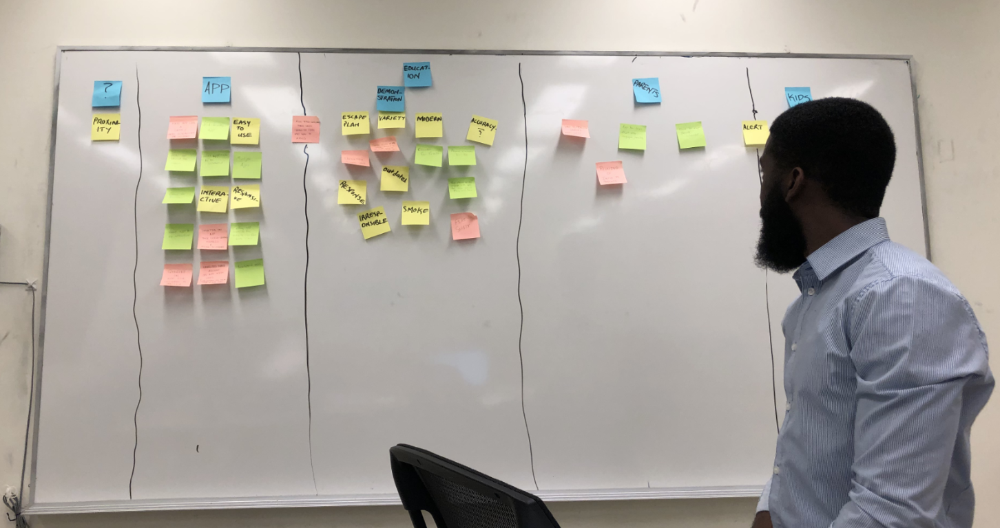
Rationale
Affinity Diagram

Slide 5
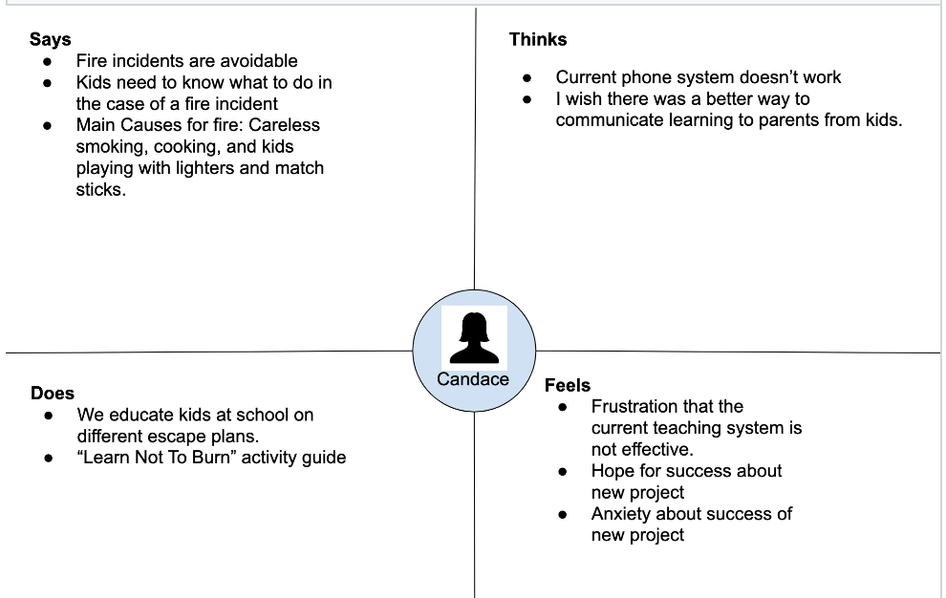
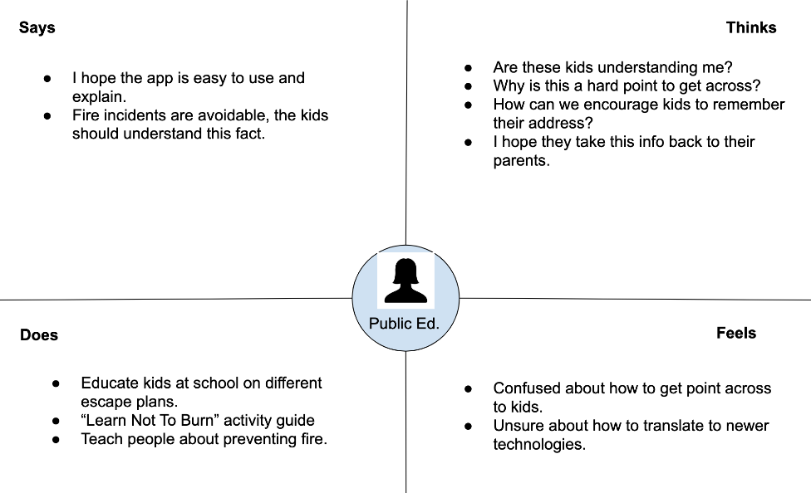
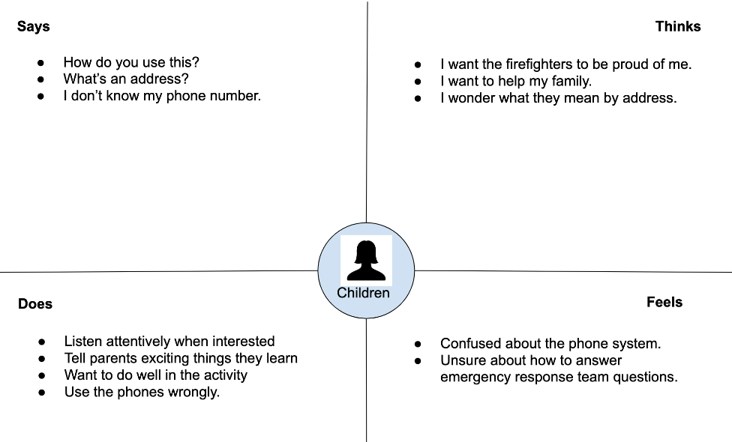
Rationale
Empathy Maps

Slide 6

Requirements & Framing
MVP Vision:
Create application for kids to practice having convo with 911 operator
Create demonstrations with familiar phone interfaces
Translate learned information to the parents at home
Enable children and parents to practice the information at their own time and will.

Slide 7
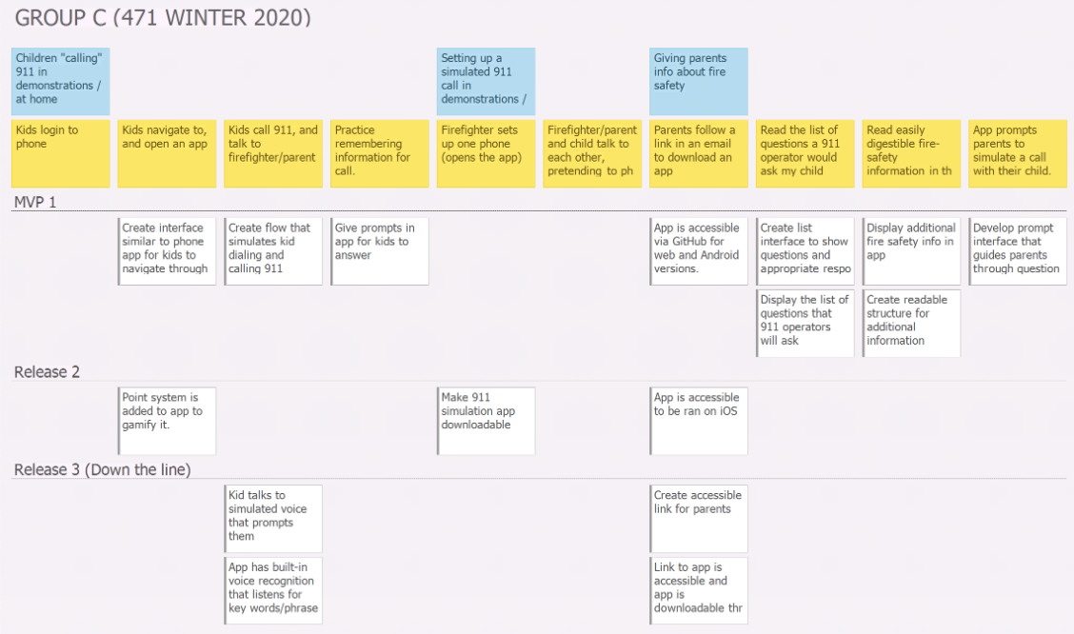
USM

Slide 8

Lo-Fi to Hi-Fi
Three Lo-Fi diagrams
Conversation with Candace
Pinpoint best attributes of each
Created Hi-Fi (best of all three worlds)

Slide 9
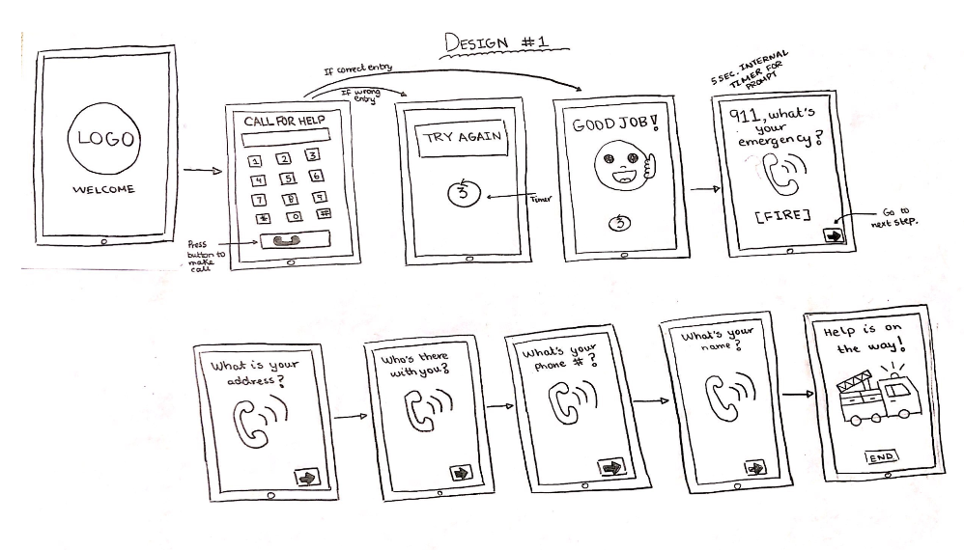
Lo-Fi # 1

Slide 10
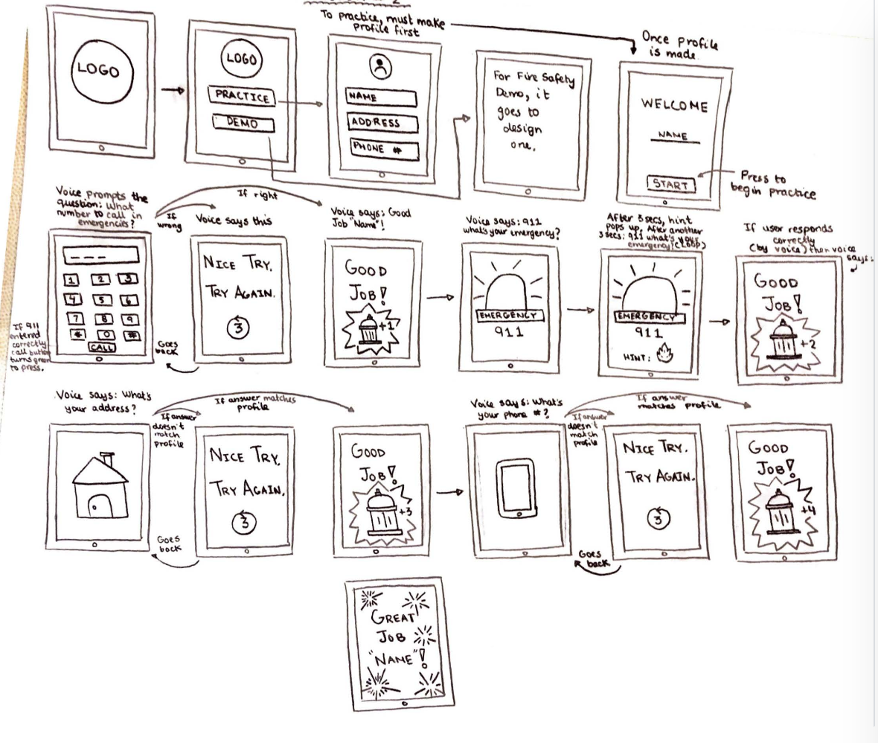
Lo-Fi #2

Slide 11
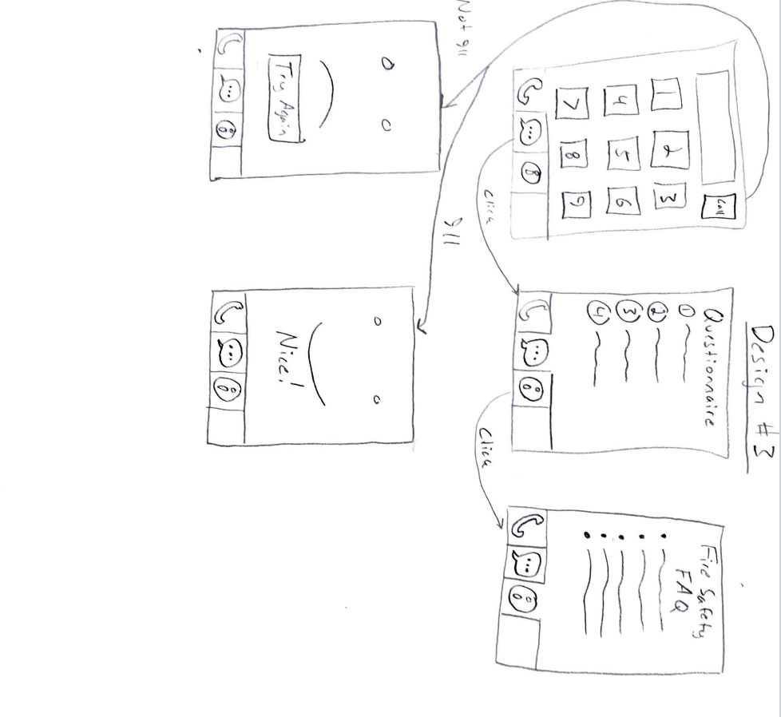
Lo-Fi #3

Slide 12
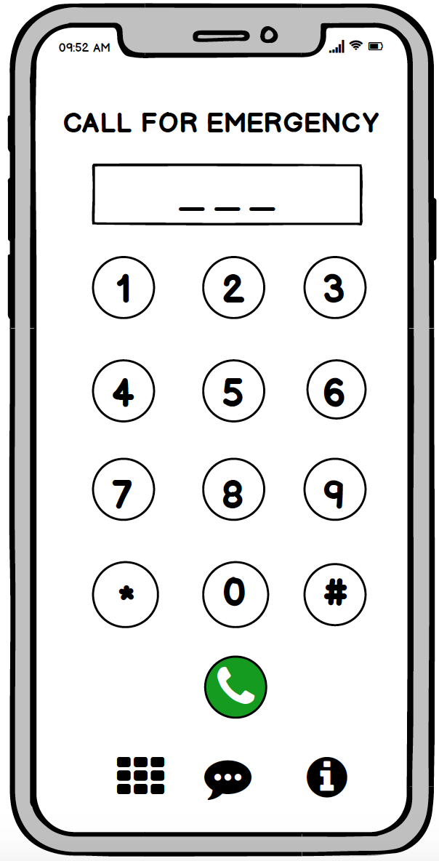
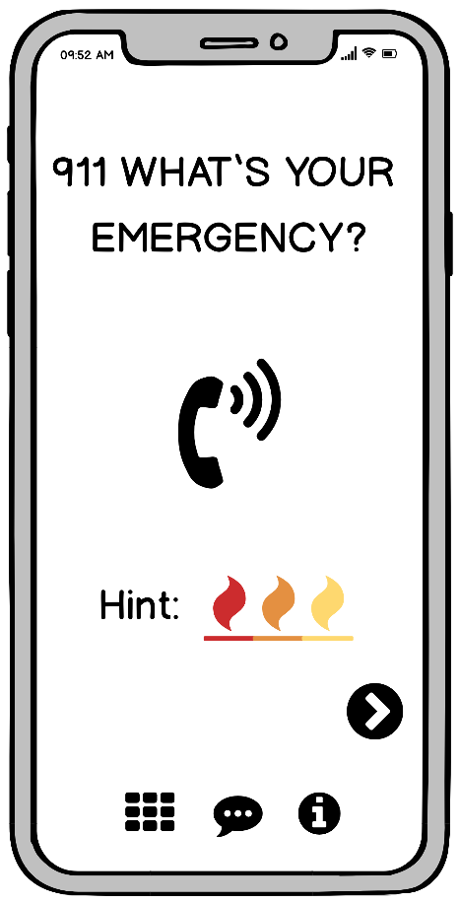
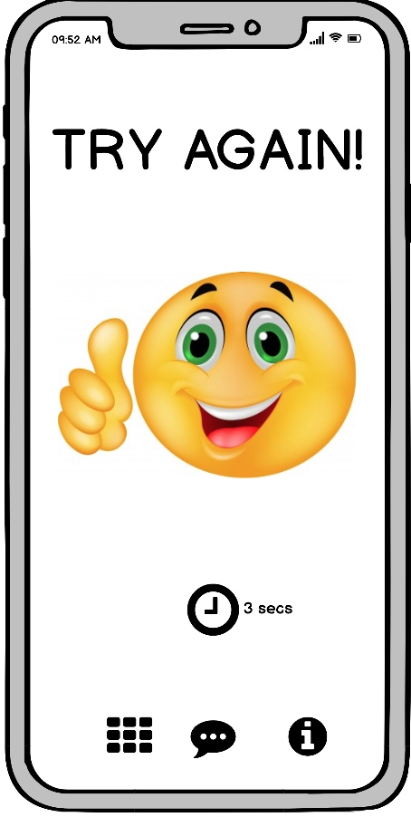
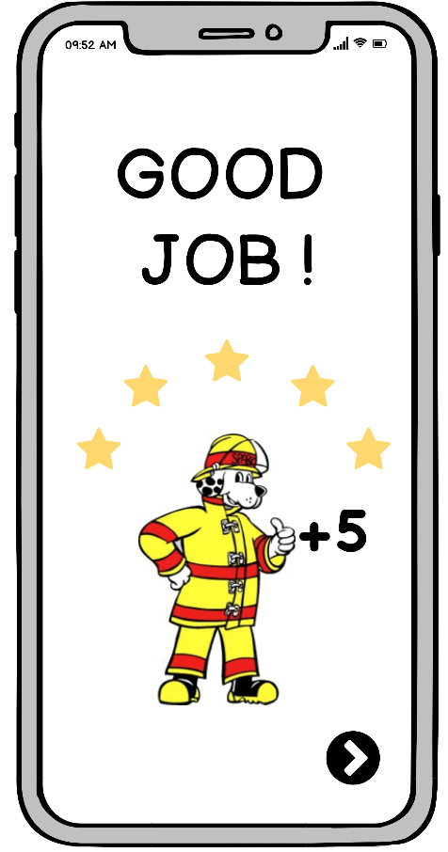
Hi-Fi

Slide 13

Team Work & Responsibilities
Great cohesive team
Raymond: Lead Developer
Jaskirat: Design
Samuel: Design

Slide 14

Development
Ionic
Uses React.js inside
Create pages filled with components that render into HTML
Android testing is done using Android Studio and Android emulators/devices
iOS testing must be done via XCode, which is only available on Mac.
This was a limitation
Image ref: https://en.wikipedia.org/wiki/Ionic_(mobile_app_framework)

Slide 15

Solution Demo

Slide 16

Constraints
Limitations
Limited app developing experience
Time
No real opportunity to test with children and firefighters

Slide 17
Future Deliverables
IOS version
More interactive game (levels/badges)
Print out escape plan

Slide 18
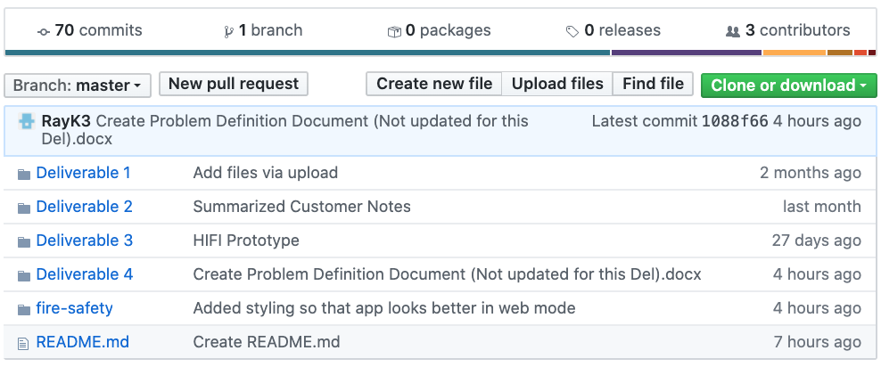

Github

Slide 19

Group Reflection
How did you feel about this project? Like? Dislike?
Great experience to work with a client
Learn to work with a diverse team
What did you learn about yourself as you collaborated and worked through this project?
Enhance each other’s strengths
How will you use what you have learned on this project going forward?
Managing and organizing a team
Prepare well

Slide 20

FIN

